Slide 1
Welcome To
Beaudelaire’s
Tutorial
Tutorial #6

Slide 2
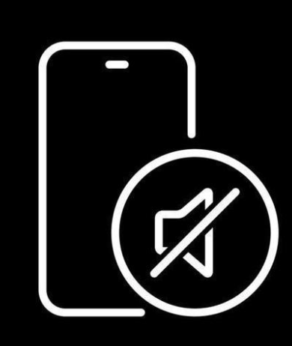
Please put your phone on silent mode to avoid interruptions

Slide 3
Questionnaire

Slide 4
Which of the following statements about JavaScript is correct?
A. JavaScript must be compiled before running.
B. JavaScript can only be run in a web browser.
C. JavaScript can run on both client and server side.
D. JavaScript cannot handle event-driven programming.

Slide 5
Who originally developed JavaScript, and what was its initial name?
A. Brendan Eich, JavaScript
B. Brendan Eich, LiveScript
C. James Gosling, JavaScript
D. James Gosling, LiveScript.

Slide 6
Which of the following results in string concatenation?
A. 1 + 2
B. "1" + 2
C. 1 + "2"
D. Both b and c

Slide 7
What is the output of the following code? console.log( "5" - 3 );
A. 2
B. "2"
C. NaN
D. Error

Slide 8
What is the output of the following code?
+true;
! 'Lydia';
A. 1 and false
B. false and NaN
C. false and false
D. 1 and true

Slide 9
What is the output of the following code? console.log( 1 + "2" + "2" );
A. 122
B. 32
C. NaN2
D. NaN

Slide 10
Which JavaScript feature allows functions to be passed as arguments to other functions?
A. Prototypal inheritance
B. Lambda
C. Hoisting
D. Event bubbling

Slide 11
What is the output of the following code? console.log( 0 == false );
A. true
B. false
C. NaN
D. Undefined

Slide 12
What is the output of the following code? console.log( typeof NaN);
A. NaN
B. number
C. string
D. undefined

Slide 13
What is the output of the following code? console.log(('b' + 'a' + + 'a' + 'a').toLowerCase());
A. bananaa
B. baaa
C. banana
D. ananas

Slide 14
What is the output of the following code? console.log(true + false);
A. truefalse
B. 1
C. error
D. NaN

Slide 15
Which method is used to parse a string and return an integer in JavaScript?
A. parseInt()
B. parseFloat()
C. toString()
D. Number()

Slide 16
What is the result of the following expression? true == "true"
A. true
B. false
C. undefined
D. error

Slide 17
What is the output of the following code? console.log( (null - 0) + "0” );
A. null0
B. 00
C. 0
D. NaN

Slide 18
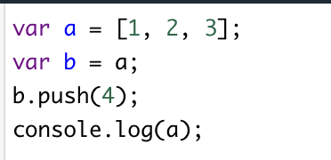
What does the following code output?
A. [1, 2, 3]
B. [1, 2, 3, 4]
C. [4, 1, 2, 3]
D. undefined

Slide 19
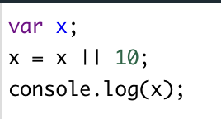
What does the following code output?
A. 0
B. 10
C. NaN
D. undefined

Slide 20
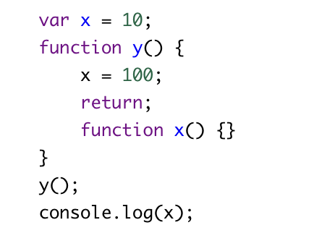
What does the following code output?
A. 100
B. 10
C. Error
D. undefined

Slide 21
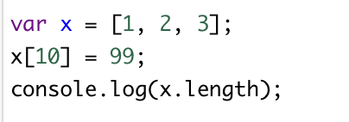
What does the following code output?
A. 3
B. 10
C. 4
D. 11

Slide 22
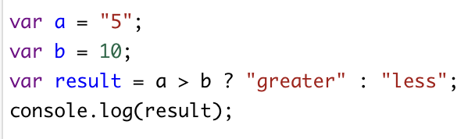
What does the following code output?
A. greater
B. less
C. undefined
D. error

Slide 23
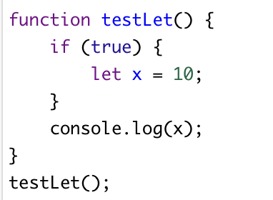
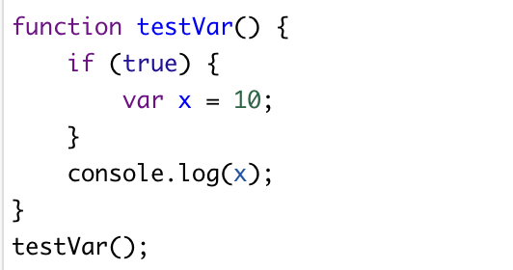
What will be the outputs for testLet and testVar respectively
A. 10, 10
B. 10, undefined
C. error, 10
D. error, error

Slide 24
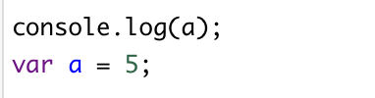
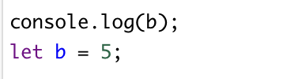
What will be the outputs for 1 and 2 respectively
A. 5, error
B. error, 5
C. 5, 5
D. undefined, error
1
2

Slide 25
Which of the following is true about null in JavaScript?
A. typeof null returns "null"
B. null is equal to undefined
C. null is an object
D. null has a length of 0

Slide 26
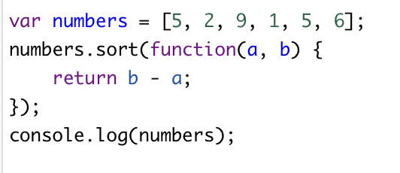
What will be the output of the following code snippet?
A. [9, 6, 5, 5, 2, 1]
B. [1, 2, 5, 5, 6, 9]
C. [1, 5, 2, 6, 5, 9]
D. [5, 2, 9, 1, 5, 6]

Slide 27
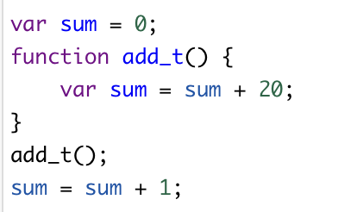
What is the final value of variable sum after the following JavaScript code is executed?
A. 20
B. 0
C. 1
D. 21
E. None of the above

Slide 28
How How do you import a JavaScript file into an HTML document?
A. <import src="myScript.js">
B. <link href="myScript.js">
C. <script src="myScript.js"></script>
D. <include src="myScript.js"></include>

Slide 29
True or False: JavaScript has five primitive types: Number, String, Boolean, Undefined, and Null.

Slide 30
True or False: The following code will print true console.log(NaN == NaN);

Slide 31
True or False: The following code will print true console.log(0.1 + 0.2 == 0.3);

Slide 32
True or False: console.log(3 > 2 > 1); prints true?

Slide 33
True or False: does "hello".split("") has the same effect as […"hello"]?

Slide 34
Write functions that will do the following
Write a JavaScript function that accepts two arguments, a string and a letter and the function will count the number of occurrences of the specified letter within the string.
Sample arguments : 'w3resource.com', 'o'
Expected output : 2
Write a JavaScript function that checks whether a passed string is a palindrome or not?
A palindrome is word, phrase, or sequence that reads the same backward as forward, e.g., madam or was it a car or a cat I saw
Write a JavaScript function that accepts a number as a parameter and checks whether it is prime or not using recursion.
Note : A prime number (or a prime) is a natural number greater than 1 that has no positive divisors other than 1 and itself.
Write a JavaScript function to extract unique characters from a string.
Example string : "thequickbrownfoxjumpsoverthelazydog"
Expected Output : "thequickbrownfxjmpsvlazydg"

Slide 35

The End

