Slide 1
Welcome To
Beaudelaire’s
Tutorial
Tutorial #3

Slide 2
Please put your phone on silent mode to avoid interruptions

Slide 3
Trivial

Slide 4
Which attribute of the <select> tag determines the number of options visible in the dropdown menu?
A. selected
B. name
C. size
D. value

Slide 5
Which of the following HTML snippets correctly creates a checkbox that is checked by default and belongs to a form for selecting groceries?
A. <input type="checkbox" name="groceries" value="milk" checked>
B. <input type="checkbox" value="milk" name="groceries[]">
C. <input type="checkbox" name="groceries" checked value="milk">
D. <input type="checkbox" name="groceries[]" value="milk” checked="checked">
Note: An array notation for the name is important if multiple values need to be submitted.

Slide 6
Which of the following is true about the <audio> element?
A. It automatically plays the second audio source listed.
B. It only supports the MP3 format.
C. The browser skips the content inside the <audio> element if it can play one of the sources.
D. The <audio> element does not require any attributes to function.

Slide 7
Which attribute can be used to specify a preselected option in a dropdown menu?
A. default
B. selected
C. preselect
D. option

Slide 8
How many options will be visible in the dropdown if the size attribute is set to 3 and there are 5 options listed?
A. 1
B. 3
C. 5
D. Depends on the browser

Slide 9
Which HTML element is used to define a section of navigation links?
A. <section>
B. <nav>
C. <header>
D. <footer>

Slide 10
What will be the output if the <video> or <audio> element contains multiple sources but the browser does not support any of the provided formats?
A. The video or audio will not display anything.
B. The browser will show the fallback content inside the <video> or <audio> tag.
C. The browser will throw an error.
D. The browser will try to download the video or audio.

Slide 11
Which of the following is NOT a valid attribute for the <video> element?
A. autoplay
B. controls
C. preload
D. loop
E. none of the above

Slide 12
What does the title attribute provide in an HTML element?
A. The main heading of the page.
B. A tooltip that appears when the mouse hovers over the element.
C. A description for screen readers.
D. A CSS style definition.

Slide 13
Which attribute is used to uniquely identify an HTML element?
A. name
B. id
C. class
D. style

Slide 14
Which attribute in the <textarea> element defines the number of visible text lines?
A. cols
B. rows
C. size
D. length

Slide 15
What is a key advantage of using external CSS files?
A. It allows CSS to be applied only to a single HTML document.
B. It makes the HTML document larger and slower to load.
C. It provides a way to style multiple HTML documents with a single CSS file.
D. It requires embedding CSS code directly into the HTML document.

Slide 16
How can you include an external CSS file in an HTML document?
A. <style src="styles.css"></style>
B. <link rel="stylesheet" type="text/css" href="styles.css">
C. <script href="styles.css"></script>
D. <include href="styles.css"></include>.

Slide 17
Which HTTP method is generally considered safer in terms of exposing sensitive data?
A. GET
B. POST
C. PUT
D. DELETE.

Slide 18
True or False: The autoplay attribute in the <video> element causes the video to start playing as soon as it is loaded.

Slide 19
True or False: The “selected” attribute can be used in any HTML element to set it as preselected?

Slide 20
True or False: An HTML document can have multiple <header> elements?

Slide 21
True or False: The <footer> element in HTML must contain the copyright information for the webpage?

Slide 22
True or False: The <audio> element supports the attributes autoplay, controls, and loop?

Slide 23
True or False: The <video> element requires the controls attribute to be specified in order for playback controls to appear?

Slide 24
True or False: The title attribute in HTML is used to define the main title of a webpage, displayed in the browser's title bar.

Slide 25
True or False: The <nav> element is used to define a block of navigation links.

Slide 26
Inline Vs Block Elements
need their own space and take up the whole line.
Inline
Inline
Inline
Inline
Block
fitting in nicely with their neighbors without causing a scene!
Block
Block
Block
Block Elements: p, div, pre, h1-h6, …
Inline Elements: a, span, img, br, b, …

Slide 27
Describe the difference between inline, block, and inline-block elements in HTML. Provide examples of each type of element.

Slide 28
<!DOCTYPE html> <html lang = "en" > <head> <title>Page Title</title> </head> <body> <div style="color:red; font-size: 2rem;"> Some Inline Style </div> </body> </html>
HTML + CSS
<!DOCTYPE html> <html lang = "en" > <head> <title>Page Title</title>
<style type="stylesheet">
div{
color: blue;
font-size:3rem;
}
</ style> </head> <body> <div> Some internal Style </div> </body> </html>
html file
<!DOCTYPE html> <html lang = "en" > <head> <title>Page Title</title>
<link rel="stylesheet" href="styles.css" /> </head> <body> <div> Some internal Style </div> </body> </html>
styles. css file
div {
color: blue;
font-size:3rem;
}
Inline styling
Internal styling
External styling
Highest priority
Second Highest priority
Least priority

Slide 29
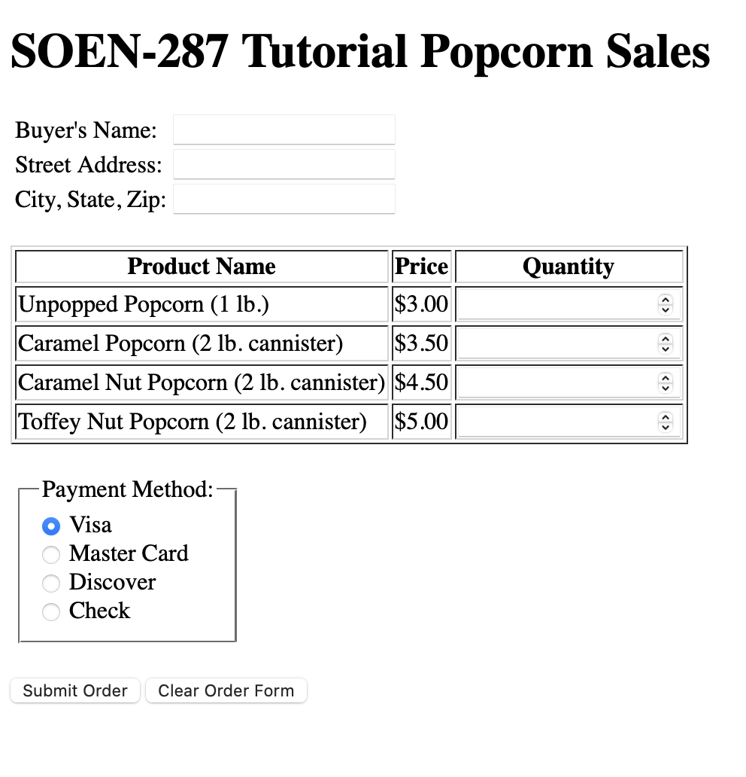
OR
Exercise I: Complete the blanks(___) in the code available at the link on the left to match the output on the right
Click Here

Slide 30
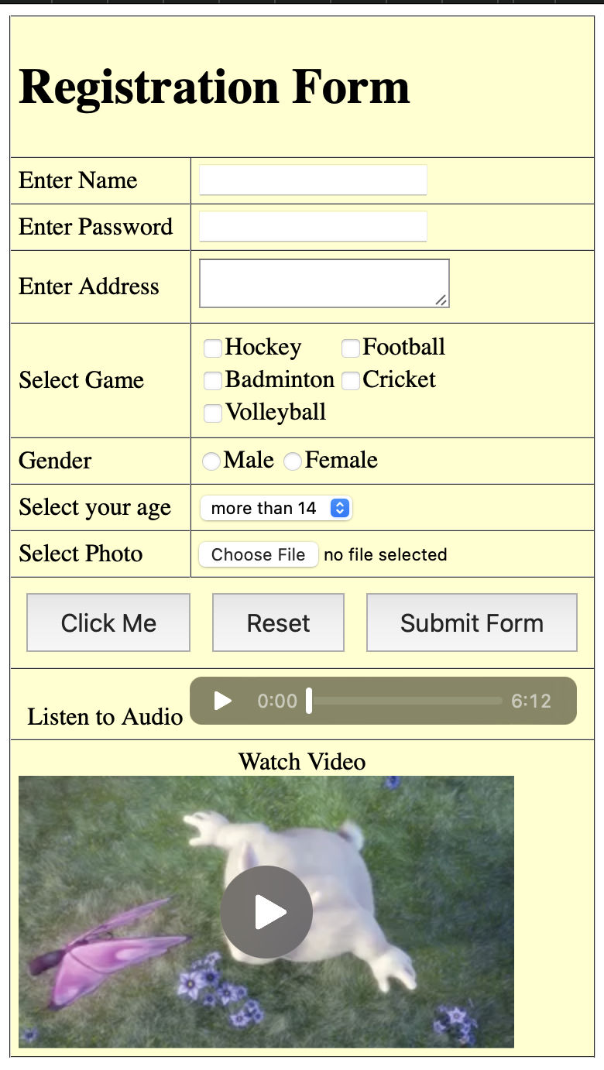
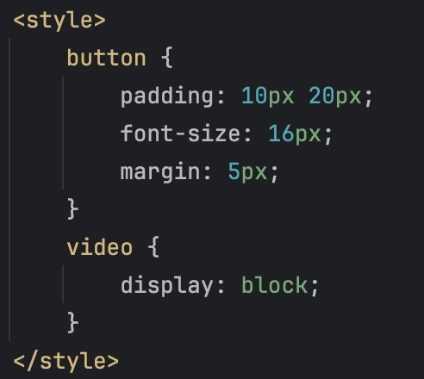
Exercise II
Using the <h1>, form and table elements, recreate the given page.
Hint
- audio used: https://www.soundhelix.com/examples/mp3/SoundHelix-Song-1.mp3
- video used: https://www.w3schools.com/html/mov_bbb.mp4
- add cellpadding="5” to your table element
- add to the head of your html

Slide 31
The End

