Slide 1
Welcome To
Beaudelaire’s
Tutorial
Tutorial #4

Slide 2
Please put your phone on silent mode to avoid interruptions

Slide 3
Knowledge Check

Slide 4
Which of the following is the correct full form of CSS?
A. Cascading Style Sheets
B. Computer Style Sheets
C. Cascading Syntax Sheets
D. Complex Styling System

Slide 5
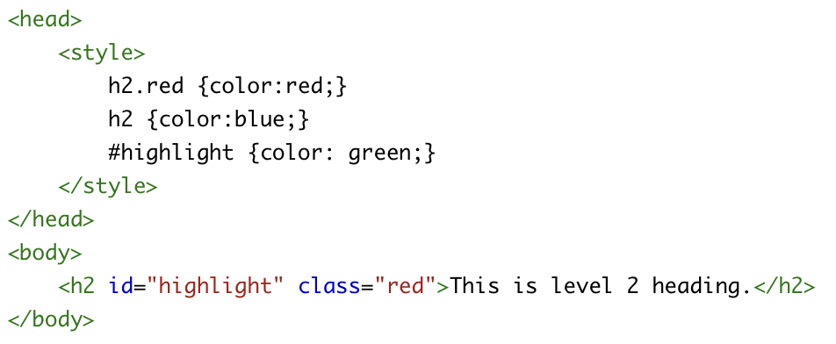
Given this code, in which color will the level 2 heading be displayed after applying the specified styles?
A.Black
B. Red
C. Green
D. Blue

Slide 6
How do you add a background color for all <h1> elements?
A. all.h1 {background-color:#FFFFFF}
B. #h1 {background-color:#FFFFFF}
C. h1 {background-color:#FFFFFF}
D. . h1 {background-color:#FFFFFF}

Slide 7
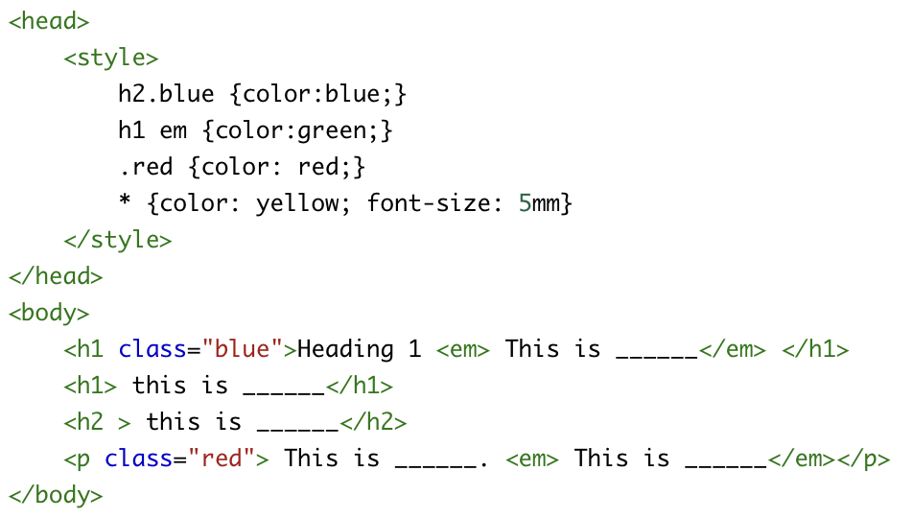
Determine the colors that will be applied to each of the blank lines in the rendered browser output. Choose the correct sequence of colors:
A. yellow, green, green, red, blue
B. blue, green, yellow, red, green
C. green, yellow, yellow, red, green
D. yellow, yellow, yellow, red, green
E. green, yellow, yellow, red, yellow

Slide 8
Which of the following CSS properties is NOT inherited by default?
A. color
B. font-family
C. margin
D. text-align

Slide 9
Which selector would select all elements that are next siblings of a specified element?
A. div + p
B. div > p
C. div ~ p
D. div p

Slide 10
Which property would you use to add space between the content of an element and its border?
A. margin
B. padding
C. border-spacing
D. spacing

Slide 11
How do you make a list item marker appear as a square?
A. list-style-type: circle
B. list-style-type: square
C. list-type-style: square
D. list-style: square

Slide 12
In CSS, which of the following selectors is the most specific?
A. h1
B. #id
C. .class
D. *

Slide 13
Which of the following statements about the float property is correct?
A. Floats are used to center-align block-level elements.
B. Floats allow text to wrap around an element.
C. Floats are deprecated in modern CSS.
D. Floats can only be used with images.

Slide 14
What does the z-index property do?
A. Sets the stack order of an element
B. Specifies the zoom level of an element
C. Controls the visibility of an element
D. Sets the background color of an element.

Slide 15
In which situation will the !important declaration not override other styles?
A. When another !important rule with higher specificity is present
B. When used inside an inline style
C. When used in an external stylesheet
D. When the browser does not support CSS3

Slide 16
In what scenario should you consider using !important?
A. When you want to debug CSS issues temporarily
B. When you want to ensure that a critical style is applied regardless of other styles
C. When you want to increase the specificity of a selector
D. Both A and B

Slide 17
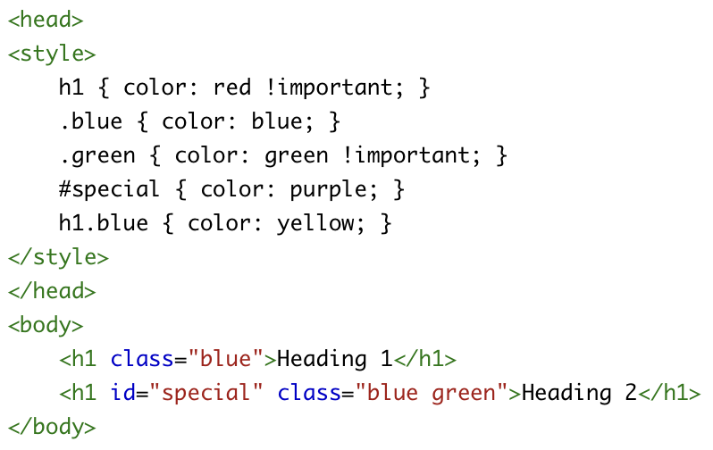
Determine the final rendered colors of the headings on a browser. Choose the correct sequence:
A. red, green
B. yellow, purple
C. red, purple
D. yellow, green

Slide 18
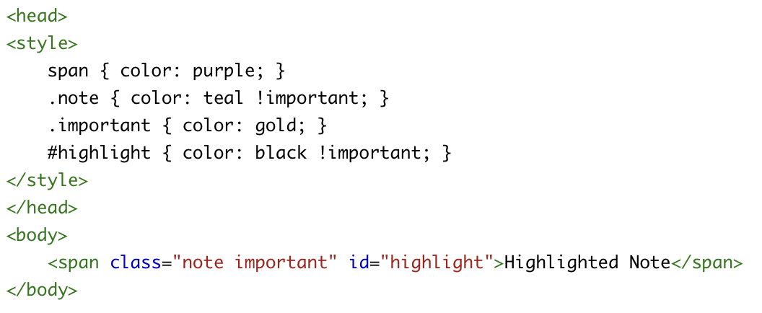
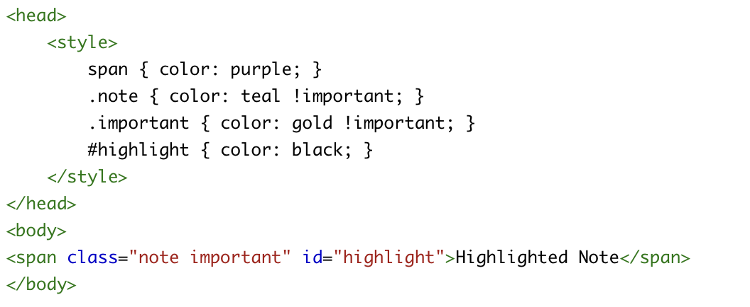
In each scenario, what will be the final color of the “Highlighted Note” as displayed in a browser?
Scenario 1
A. Scenario 1: teal, Scenario 2: gold
B. Scenario 1: black, Scenario 2: teal
C. Scenario 1: black, Scenario 2: gold
D. Scenario 1: purple, Scenario 2: black
Scenario 2

Slide 19
Which of the following methods best enforces a responsive design strategy focusing on mobile-first development?
A. Begin designing for desktop screens and progressively enhance for mobile.
B. Create a separate mobile version of the website.
C. Start by designing for mobile devices and use media queries for larger screens.
D. Use fixed widths and heights for all elements..

Slide 20
Which selector combination would correctly apply styles to all <p> tags within a <div> but not within any other element?
A. div p
B. p div
C. div + p
D. p > div.

Slide 21
How would you select only the first child element of a <div>?
A. div:first-child
B. div:first
C. div > child:first
D. div > :first-child.

Slide 22
How can you ensure an element is hidden but still takes up space in the layout?
A. visibility: hidden;
B. display: none;
C. opacity: 0;
D. z-index: -1;

Slide 23
How would you apply a 5-pixel border to only the left side of a <div> element?
A. border-left: 5px;
B. border-left-width: 5px;
C. border-left-style: 5px;
D. border-left-size: 5px;

Slide 24
Which CSS rule will apply to a hyperlink that has been visited and is currently being clicked on?
A. a:link:active
B. a:visited:active
C. a:hover:active
D. a:active:visited

Slide 25
True or False: Inline CSS styles override external CSS styles.

Slide 26
True or False: The z-index property can be used on elements with position: static.

Slide 27
True or False: “em” and “rem” units are relative to the root element’s font size.

Slide 28
True or False: The calc() function in CSS can be used to perform arithmetic operations to set property values.

Slide 29
True or False: CSS Flexbox is designed for creating one-dimensional layouts.

Slide 30
True or False: Using !important in a CSS rule increases its specificity

Slide 31
True or False: The @media rule is used to apply different styles for different media types or devices.

Slide 32
True or False: If an element has both inline styles and styles from an external stylesheet, the inline styles will take precedence unless the external styles use !important.

Slide 33
CSS selectors and combinators
Run the code available at the provided link to view the explanations.
You can execute the code on:
https://www.w3schools.com/html/tryit.asp?filename=tryhtml_default
Or
Click here

Slide 34
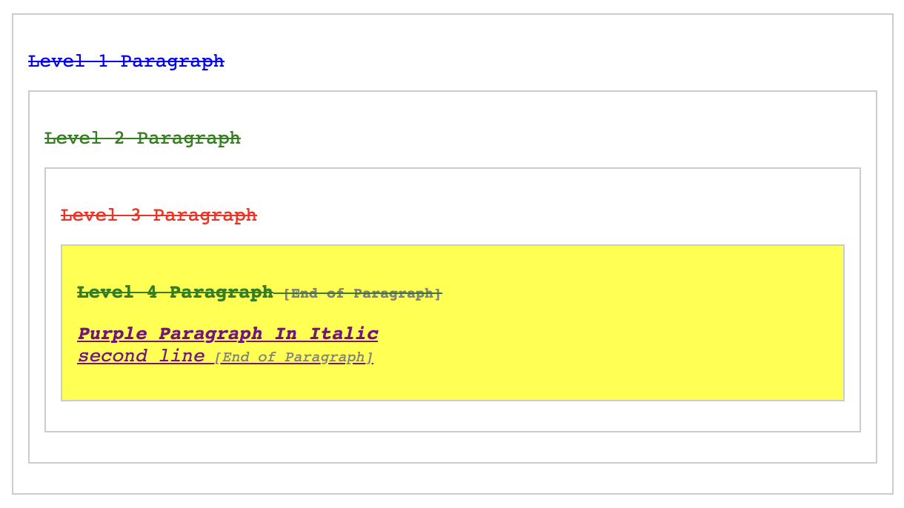
Using the following selectors, use this HTML structure on the left, “AS IS DON’T CHANGE IT” to get what’s on the right side: classes, descendant, child, id, attribute, pseudo-class, adjacent sibling, general sibling, pseudo-element, and universal selectors.
The HTML Structure is available here
OR
Click here

Slide 35
Responsive design
Run the code available at the provided link to view examples.
You can execute the code on:
https://www.w3schools.com/html/tryit.asp?filename=tryhtml_default
Or
Click here

Slide 36
The End

