Slide 1
Welcome To
Beaudelaire’s
Tutorial
Tutorial #5

Slide 2
Please put your phone on silent mode to avoid interruptions

Slide 3
Questionnaire

Slide 4
What is the correct way to write a comment in a CSS document?
A. <!-- This is a comment ->
B. /* This is a comment */
C. <!-- This is a comment -->
D. // This is a comment

Slide 5
What does the following viewport meta tag do? <meta name="viewport" content="width=device-width, initial-scale=1">
A. Sets the width of the page to the width of the user's device screen
B. Sets the initial zoom level of the page to 1.0
C. Both A and B
D. None of the above

Slide 6
Which CSS rule is used to create a media query for screens that are 600px or smaller?
A. @media screen and (min-width: 600px) {...}
B. @media only screen and (min-width: 600px) {...}
C. @media only screen and (width: 600px) {...}
D. @media screen and (max-width: 600px) {...}

Slide 7
Which of the following pseudo-classes can be used to style an element when it is the first and only child within its parent?
A. :first-child
B. :nth-child(1)
C. :only-child
D. A and B
E. All of the above

Slide 8
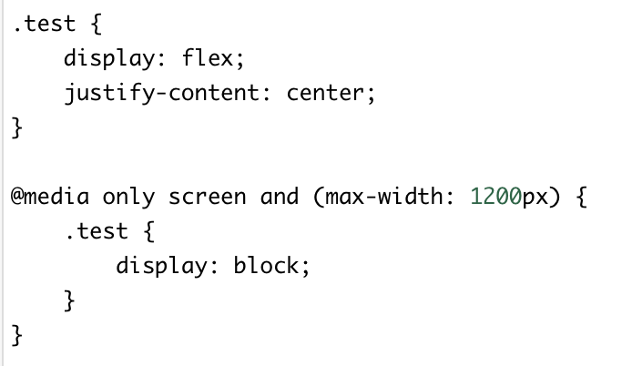
What will be the effect of the following CSS rule when applied to a <div> with the class .test on a screen width of 1000px?
A. The <div> will be displayed as a flex container
B. The <div> will be displayed as a block element
C. The <div> will get confused, an Error occurs
D. None of the above

Slide 9
Which CSS property is used to create space inside the element, between the element and its border?
A. margin
B. padding
C. border
D. content

Slide 10
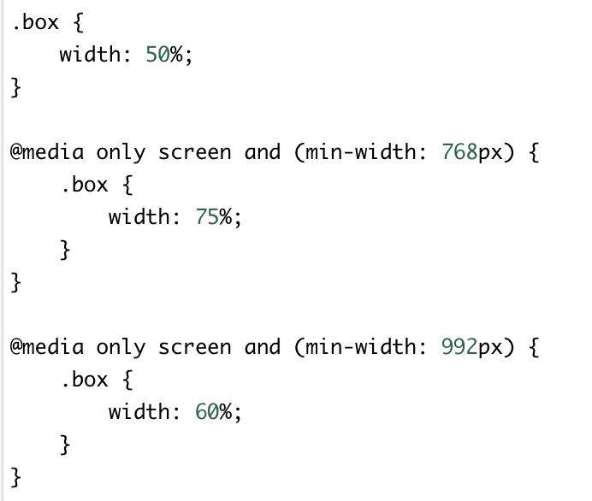
Consider the following CSS. What will be the width of an element with the class .box on a screen width of 1200px?
A. 50%
B. 75%
C. 60%
D. 100%

Slide 11
In CSS, h1 can be called as
A. Selector
B. Attribute
C. value
D. tag

Slide 12
For For the CSS declaration margin: 20px 15px 10px;, what are the correct margin values for each side (top, right, bottom, left)?
A. Top: 20px, Right: 15px, Bottom: 10px, Left: 15px
B. Top: 20px, Right: 10px, Bottom: 15px, Left: 15px
C. Top: 20px, Right: 15px, Bottom: 15px, Left: 10px
D. Top: 20px, Right: 10px, Bottom: 10px, Left: 15px

Slide 13
Can negative values be allowed in padding property?
A. Yes
B. No
C. It depends
D. None of the above

Slide 14
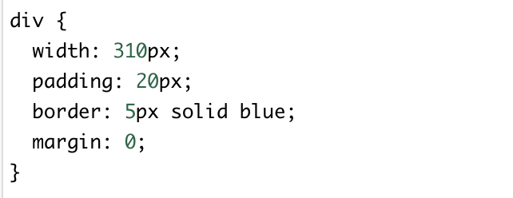
What will be the width of the div element given below?
A. 310px
B. 350px
C. 360px
D. 0

Slide 15
How can we select elements with a specified attribute in CSS?
A. [attribute] element
B. element#attribute
C. element::attribute
D. element > attribute

Slide 16
What are the uses of CSS pseudo-elements?
A. Style specific parts of an element
B. Style the first letter or line of an element
C. Insert content before and after the element
D. All of the above

Slide 17
Sample code for responsive design
Run the code available on the right.
You can execute the code on:
https://www.w3schools.com/html/tryit.asp?filename=tryhtml_default
Or
Click here

Slide 18
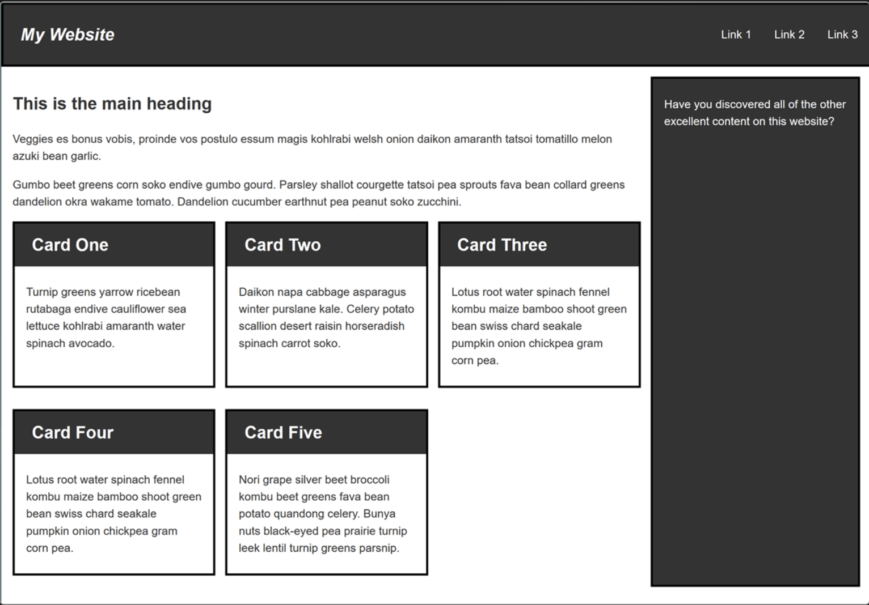
Your task is to create a desktop version of this layout which displays when there is enough screen width to accommodate it. Your final result should look like the image below:
The HTML Structure is available here
OR
Click here

Slide 19
The End

