Slide 1
Welcome To
Beaudelaire’s
Tutorial
Tutorial #12

Slide 2

Please put your phone on silent mode to avoid interruptions

Slide 3
The following questions are based on the Exercise code available at https://ta.beaudelaire.ca/soen-287/tut12-exercise

Slide 4
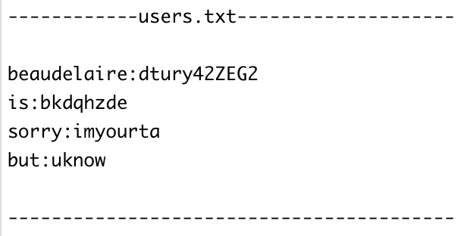
When a user enters 'beaudelaire' and 'dtury42ZEG2' into the 'username’ and 'password' field and submits the form using the HTTP GET method, what is the resulting query string appended to the URL?
A. username= beaudelaire&password=dtury42ZEG2
B. user=beaudelaire &pwd=dtury42ZEG2
C. ?user=beaudelaire:password=dtury42ZEG2
D. user=beaudelaire:password=dtury42ZEG2

Slide 5
Where in the request is the query string?
A. request body
B. in an attached file
C. request header
D. nowhere to be found

Slide 6
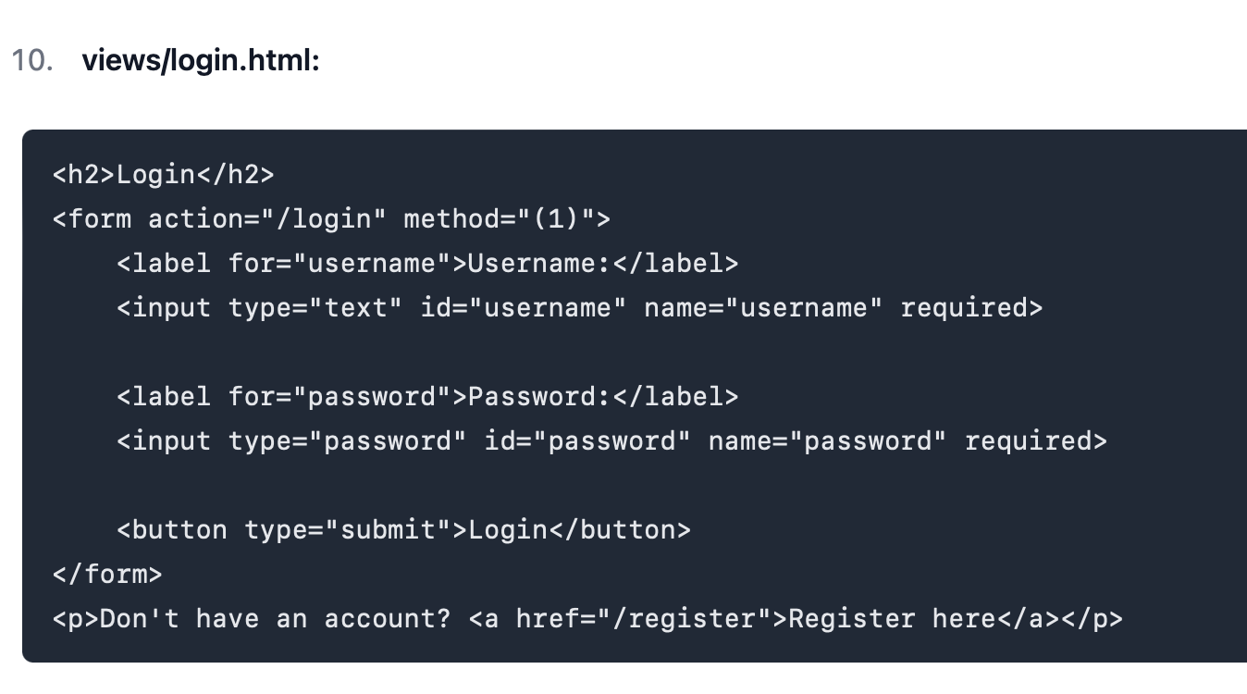
What is supposed to be at (1)?
A. GET
B. PUT
C. POST
D. UPDATE

Slide 7
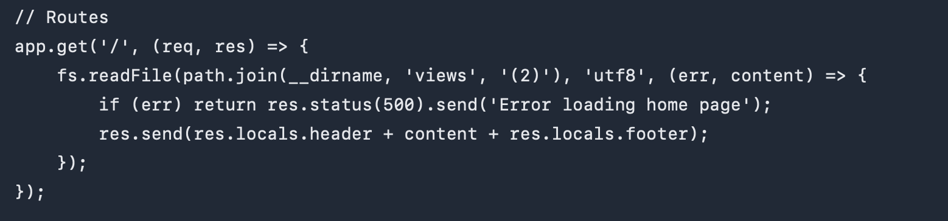
What is supposed to be at (2)?
A. home.ejs
B. home.html
C. main.js
D. header.ejs

Slide 8
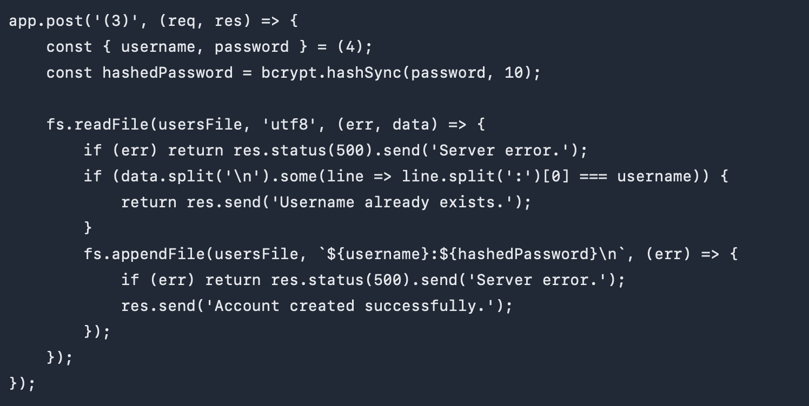
What is supposed to be at (3)?
A. /
B. /register
C. /logout
D. none of the above

Slide 9
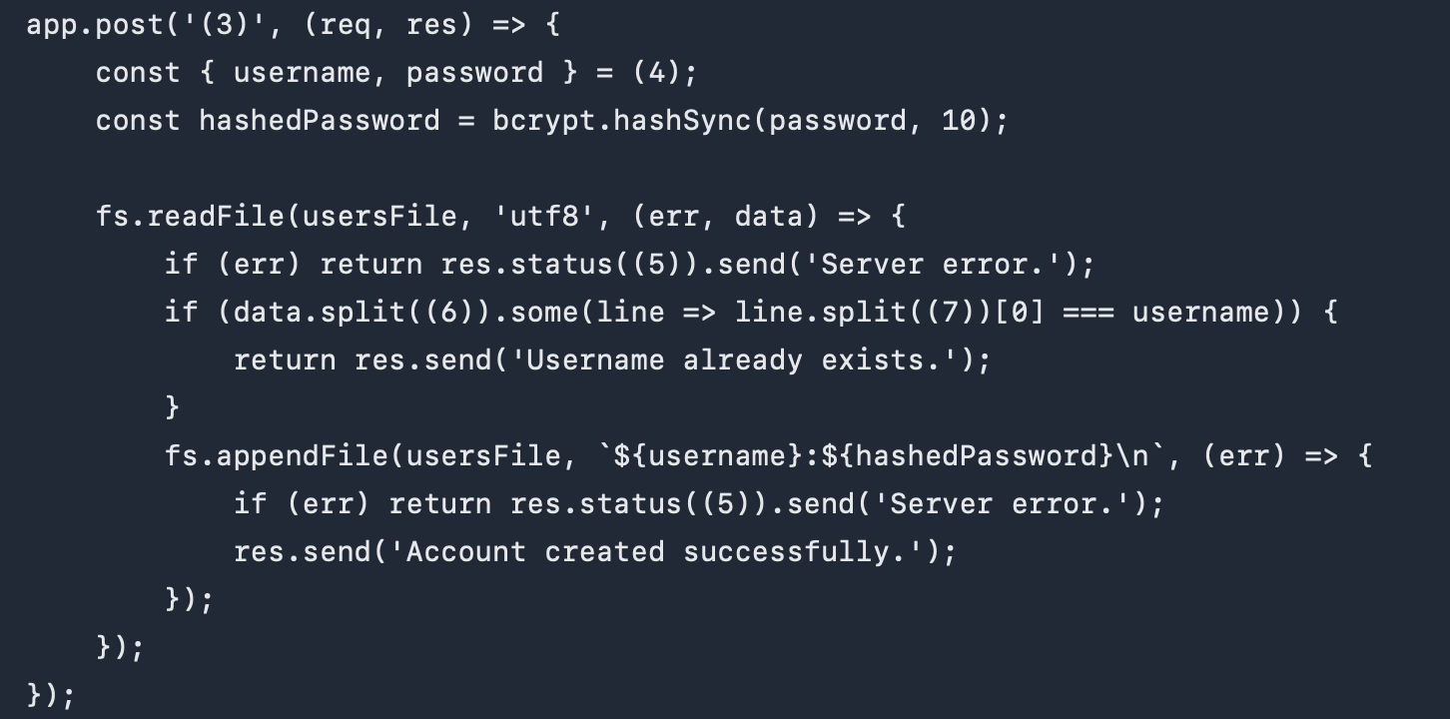
What is supposed to be at (4)?
A. res.header
B. req.header
C. res.body
D. req.body
E. req.query

Slide 10
Given const user = {username: “me”, password: “you”} what is the result of const {username, password} = user
A. error
B. username = “me”, password = “you”
C. user get removed
D. none of the above

Slide 11
1. user = {username: “me”, password: “you”, sex: “M”}
2. user.sex = “M”
Given
const user = {username: “me”, password: “you”}
what is the correct answer for each scenario
A. error
B. user’s value is {username: “me”, password: “you”, sex: “M”}
C. user’s value is {username: “me”, password: “you”}
D. none of the above

Slide 12
1. user instanceof user
2. user instanceof Object
3. user instanceof BabyGirl
Given
const user = {username: “me”, password: “you”}
what is the correct answer for each scenario
A. error
B. true
C. false
D. none of the above

Slide 13
What is supposed to be at (5)?
A. 200 or above
B. 300 or above
C. 400 or above
D. 500 or above
E. none of the above

Slide 14
What is supposed to be at (6)?
A. ' '
B. ':'
C. '/n'
E. none of the above

Slide 15
What is supposed to be at (7)?
A. ' '
B. ':'
C. '/n'
E. none of the above

Slide 16
Answer true or false to do the following after doing const data = users.split(‘/n’)
A. data is an array of strings
B. data is an array of objects
C. but:uknow is is one of the elements in data
D. data is a string

Slide 17
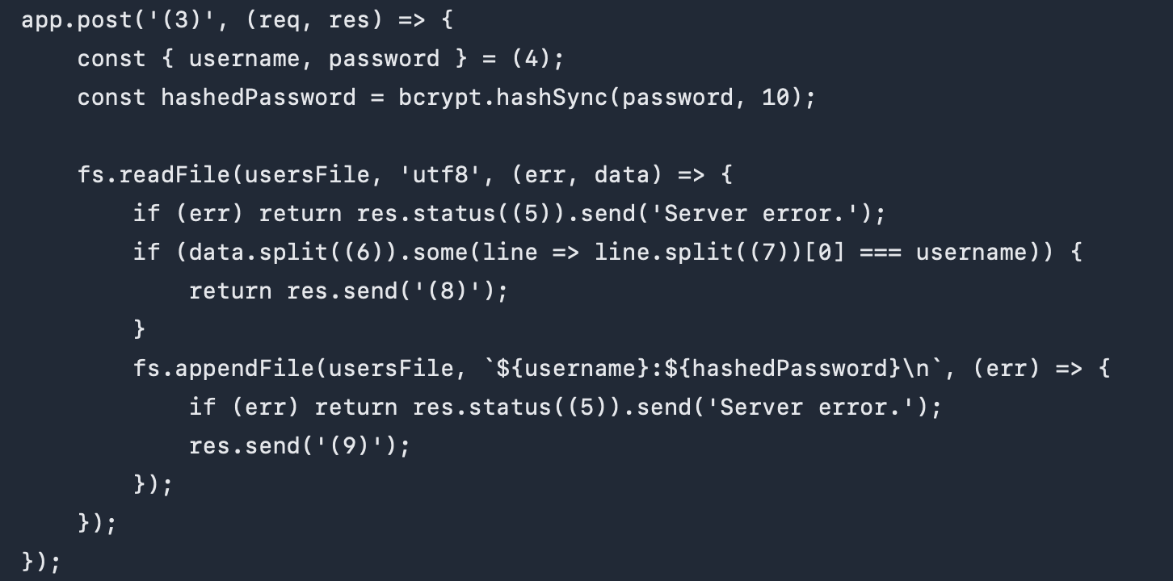
What is supposed to be at (8)?
A. Username already exists.
B. Account created successfully.
C. Password already taken
D. Password does not match
E. None of the above

Slide 18
What is supposed to be at (9)?
A. Username already exists.
B. Account created successfully.
C. Password already taken
D. Password does not match
E. None of the above

Slide 19
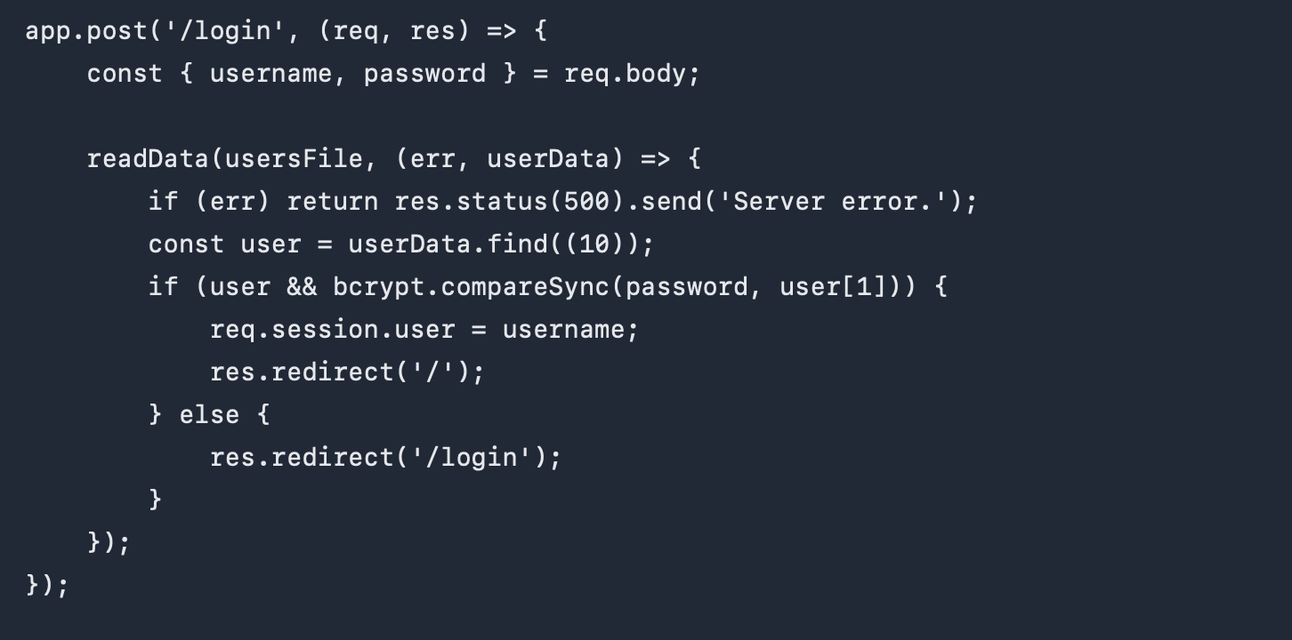
What is supposed to be at (10)?
A. u[1] === password
B. u[0] === username
C. u => u[0]
D. u => u[0] === username
E. None of the above

Slide 20
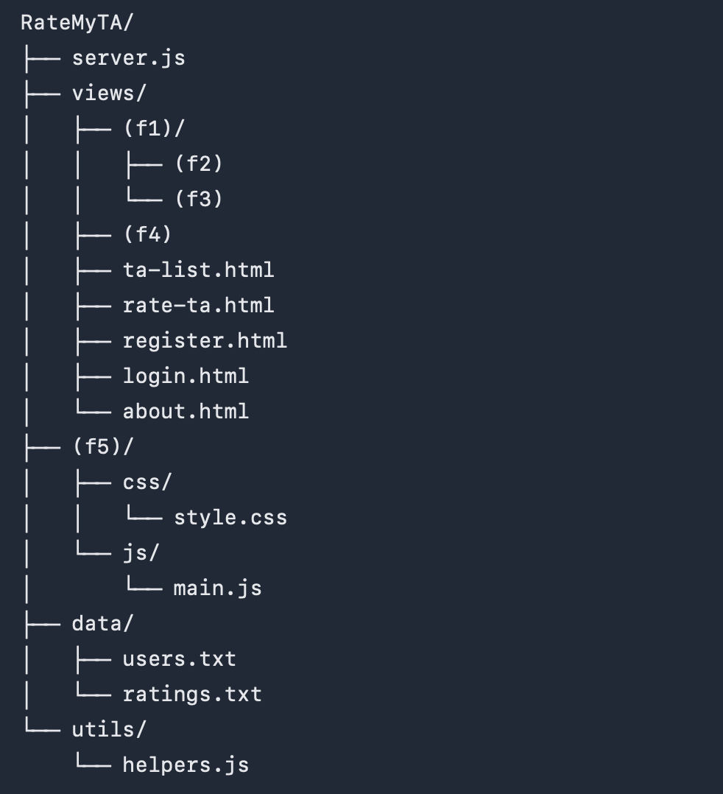
What is supposed to be at f(1)?
A. partials
B. root
C. webroot
D. public
E. None of the above

Slide 21
What is supposed to be at f(2)?
A. header.html
B. header.ejs
C. index.html
D. footer.html
E. None of the above

Slide 22
What is supposed to be at f(4)?
A. header.html
B. header.ejs
C. home.html
D. footer.html
E. None of the above

Slide 23
Where else should be place the users.txt if we don’t have a data folder
A. views
B. RateMyTA
C. public
D. None of the above

Slide 24
Which of the following is NOT a common use for cookies?
A. Session management
B. Personalization
C. Tracking
D. Storing large amounts of data

Slide 25
Which Node.js module is used for file system operations?
A. file
B. fs
C. fileSystem
D. io

Slide 26
What does it mean for HTTP to be stateless?
A. The server remembers the client’s state between requests
B. Each request is treated as an independent transaction
C. The client stores all session information
D. The server keeps track of user sessions

Slide 27
What is a cookie in web development?
A. A server-side storage mechanism
B. A name/value pair passed between a browser and a server
C. A client-side script
D. An HTML element

Slide 28
Where are cookies stored?
A. On the server
B. On the client’s device
C. In the browser’s cache
D. In the server’s memory.

Slide 29
Where are sessions stored in a typical web application?
A. On the client’s device
B. In the browser’s cache
C. On the server
D. In the database

Slide 30
What is a key advantage of using sessions over cookies?
A. They are stored on the client-side
B. They provide better security for sensitive information
C. They are easier to implement
D. They can store larger amounts of data

Slide 31
Which package is commonly used for session management in Express.js?
A. express-session
B. session-manager
C. cookie-session
D. express-cookie

Slide 32
Which method is used to read and write data respectively to a text file in Node.js?
A. fs.read(), fs.write()
B. fs.readFile(), fs.writeFile()
C. fs.getFile(), fs.setFile()
D. fs.open(), fs.open()

Slide 33
Which of the following is/false
A. After a user typed “A” into a text field (no other action), the change event does not trigger
B. The title can be an attribute for any tag
C. When a mouse moves on a client area of a browser window, multiple events are triggered
D. Cookie can be used to identify a user
E. Session variables are removed when the session is removed
F. Session ID can be stored as a cookie
G. Session ID can be initialized by the Web server or by the Web browser

Slide 34
What is the purpose of middleware in Express.js?
A. To handle routing
B. To process incoming requests before they are handled by the route
C. To create HTTP servers
D. To manage database connections

Slide 35

Q&A about the course material

