Slide 1
Welcome To
The Best Tutorial
Tutorial #2

Slide 2
Please put your phone on silent mode to avoid interruptions

Slide 3
Brain Teaser

Slide 4
Who is the inventor of HTML?
A. Tim Berners-Lee
B. Marc Andreseen
C. Bill Gates
D. Larry Ellison
E. Al Gore

Slide 5
In an HTTP request, what does the Accept header signify?
A. The encoding types the client can handle
B. The preferred content types of the response
C. The character set to use in the response
D. The IP address of the client
E. None of the above

Slide 6
HTTP responses include which of the following components?
A. Protocol, status code, headers, and body
B. Status code and protocol only
C. Headers and body only
D. HTTP methods

Slide 7
In an HTTP response header, what does the Content-Length specify?
A. The size of the header in bytes
B. The size of the response body in bytes
C. The total size of the HTTP response in bytes
D. The size of the requested resource in bytes
E. All of the above

Slide 8
What happens when you access the page www.google.com ? [Select ALL the correct answers]
A. Multiple GET requests are sent to the server
B. One POST request is sent to the server
C. Some JavaScript code is possibly downloaded from the server
D. One DNS request is sent to the server

Slide 9
Which of the following snippets of HTML is/are wrong?
A. <p>SOEN 287 Term Test!</p>
B. <p2> SOEN 287 Term Test! p2>
C. SOEN 287 Term Test! <br /> SOEN 287 Term Test!
D. <p>SOEN <b><i>287</b></i> Term Test!</p>

Slide 10
Which of the following tags are "list" tags in HTML?
A. dt
B. d
C. li
D. ol
E. il
F. td
G. ul

Slide 11
Which HTTP Status Code represents “success” status?
A. 202
B. 302
C. 401
D. 500
E. 600

Slide 12
What is the main purpose of HTTP status codes?
A. To encrypt the communication between client and server
B. To provide metadata about the HTTP request
C. To rizzzz
D. To specify MIME types for requested resources
E. none of the above

Slide 13
Which of the following statements about the <meta> tag is incorrect?
A. It provides additional information about a document.
B. It can include attributes like name, content, and charset
C. It is used to link external stylesheets
D. It is placed within the <head> section of an HTML document.

Slide 14
What is the correct way to write a comment in an HTML document?
A. <!-- This is a comment ->
B. /* This is a comment */
C. <!-- This is a comment -->
D. // This is a comment

Slide 15
Which HTML tag is used to create a description/definition list?
A. ul
B. ol
C. dl
D. li

Slide 16
How can you ensure accessibility for users with disabilities in images?
A. Adding a caption
B. Increasing the size of the image
C. Using <strong> instead of <img>
D. Using the alt attribute

Slide 17
What is a significant limitation of online website builders like Wix or Squarespace compared to custom solutions?
A. They cannot handle multimedia content
B. They offer limited backend functionality
C. They require extensive programming knowledge
D. They are not compatible with mobile browsers

Slide 18
What is the primary function of DNS in a browser-server interaction?
A. Resolve IP addresses to domain names
B. Resolve domain names to IP addresses
C. Cache browser data
D. Establish TCP connections

Slide 19
Which of the following elements can only appear in the <head> section?
A. <meta>
B. <title>
C. <link>
D. All of the above

Slide 20
Which step occurs after a browser receives an IP address from DNS?
A. HTTP request is constructed
B. Browser initiates a TCP handshake
C. Server sends an HTTP response
D. Resource is displayed

Slide 21
Which of the following attributes is used to control the vertical placement of the contents in a table cell?
A. text-align
B. cell-align
C. align
D. vertical-align

Slide 22
Which attribute is used to specify the location of an image file in an HTML document?
A. href
B. src
C. link
D. img

Slide 23
What is the purpose of the charset attribute in the <meta> tag?
A. To define the character encoding for the HTML document
B. To link an external JavaScript file
C. To specify the document's language
D. To provide additional keywords for search engines

Slide 24
How does a browser handle multiple additional resources (e.g., images, scripts) in an HTML page?
A. Opens multiple TCP connections
B. Sends additional requests over an existing connection
C. Uses the Cache-Control header to optimize loading
D. Processes all resources in parallel using DNS queries

Slide 25
Which of the following type attributes will display an ordered list with lowercase Roman numerals?
A. type="1"
B. type="A”
C. type="i"
D. type="I"

Slide 26
What is the default value for the list-style-type property in an unordered list?
A. disc
B. circle
C. square
D. none

Slide 27
What is the difference between POST and PUT methods?
A. POST creates resources, PUT replaces resources entirely
B. PUT is idempotent, POST is not
C. POST modifies resources, PUT creates them
D. Both A and B

Slide 28
What is the main drawback of the HTTP/1.1 protocol compared to HTTP/2?
A. Lack of encryption support
B. Use of multiple connections for resources
C. Inability to handle large payloads
D. Limited caching support

Slide 29
In an HTML table, which attribute is used to merge two or more cells into a single cell horizontally?
A. rowspan
B. colspan
C. merge
D. span

Slide 30
What does the CSS property border-collapse: collapse; do?
A. It merges the borders of adjacent table cells into a single border.
B. It removes all borders from the table.
C. It adds spacing between the borders of adjacent table cells.
D. It collapses the table into a smaller size by removing empty cells.

Slide 31
What is the purpose of the alt attribute of img?

Slide 32
Does the element “br” need a closing tag, why?

Slide 33
The <pre> tag is used to preserve whitespace in HTML? True or False

Slide 34
The <blockquote> tag is used to define a short quotation.? True or False

Slide 35
The default color for an unvisited link in HTML is purple? True or False

Slide 36
You can style only table, or th, or td ? True or False

Slide 37
The target="_blank" attribute value will open the linked document in a new tab or window? True or False

Slide 38
What does HTML stand for?

Slide 39
Colspan Vs Rowspan
Code available here: Click here

Slide 40
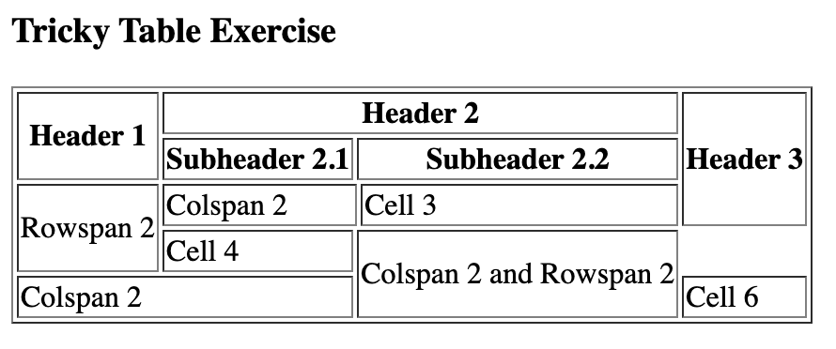
Exercise I
Using the <h3>, <table>, <th>, <tr>, and <td> elements, recreate the given page WITHOUT CSS. Also add a page title
Hint
- Use colspan and rowspan
- Use border attribute for the table element

Slide 41
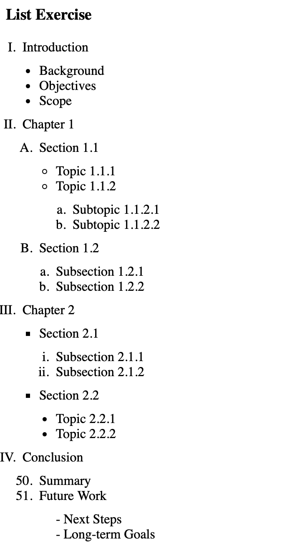
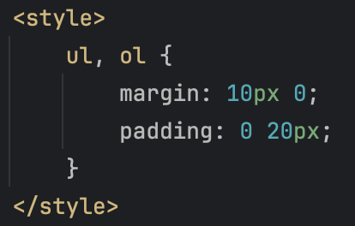
Exercise II
Using the <h3>, <ul>, <ol> and <li> elements, recreate the given page. Also add a page title
Hint
- use list-style-type to change de default bullet point for <ol> items
- use start attribute to start counting from 50
- add in the head for the spacing

Slide 42
The End

