Slide 1
Welcome To
Beaudelaire’s
Tutorial
Tutorial #10

Slide 2
Please put your phone on silent mode to avoid interruptions

Slide 3
What is the output of the following code? console.log( typeof typeof 1);
A. string
B. number
C. 1
D. true

Slide 4
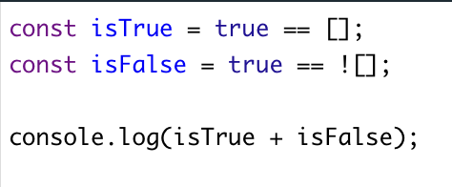
What does the following code output?
A. 1
B. 0
C. “true”
D. true

Slide 5
What does the following code output?
A. 33
B. 2
C. 8
D. 1

Slide 6
What does the following code output?
A. false, "2number", true, "apple"
B. true, "2number", false, "orange"
C. false, "NaNnumber", false, "orange"
D. true, "NaNnumber", true, "apple"

Slide 7
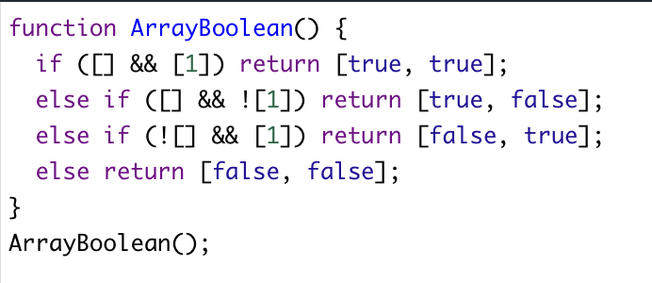
What does the following code output?
A. [true, true]
B. [false, true]
C. [true, false]
D. [false, false]

Slide 8
What is the output of the following code? let b = "4"; console.log(b +++ 3, b);
A. 44, 4
B. 8, 5
C. 7, 5
D. 43, 5

Slide 9
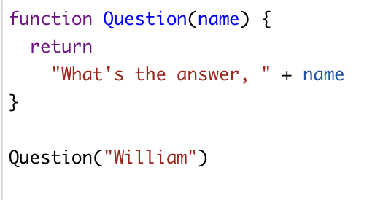
What is the output of the following code?
A. William
B. What’s the answer, William
C. What’s the answer,
D. undefined

Slide 10
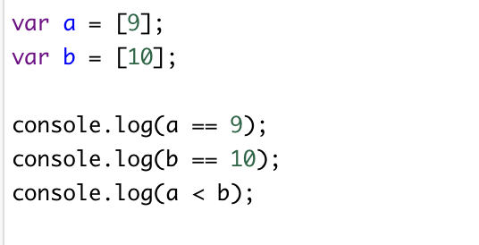
What is the output of the following code?
A. true true true
B. false false false
C. true true false
D. false false true

Slide 11
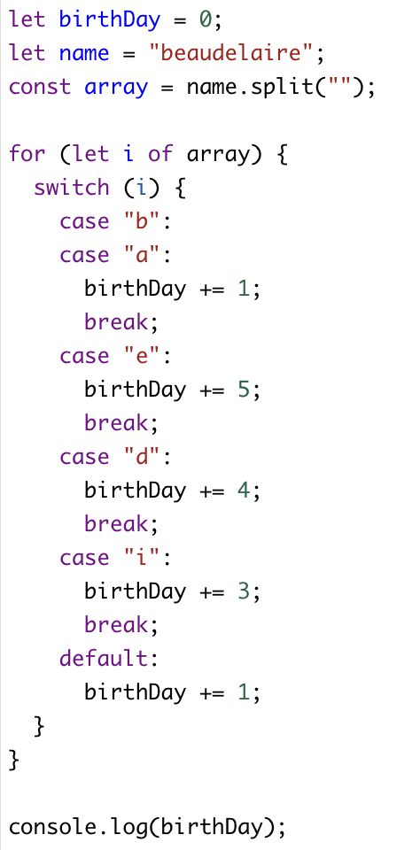
What is the output of the following code?
A. 21
B. 22
C. 27
D. 19
E. None of the above

Slide 12
What will the value of citrus be in the below code?
A. ["Banana", "Lemon"]
B. ["Lemon", "Apple"]
C. ["Orange", "Lemon"]
D. ["Orange", "Lemon", "Apple"]

Slide 13
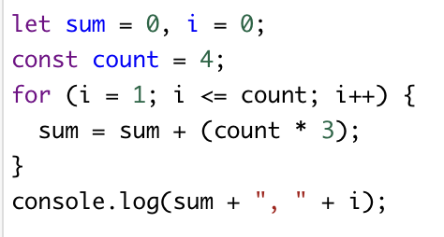
What is the output of the following code
A. 60, 5
B. 48, 5
C. 48, 4
D. 36, 4
D. None of the above programming.

Slide 14
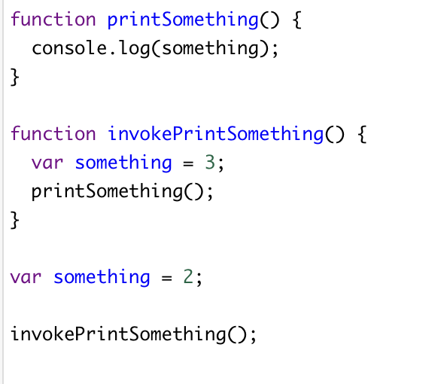
What is the output of the following code?
A. 2
B. 3
C. undefined
D. error.

Slide 15
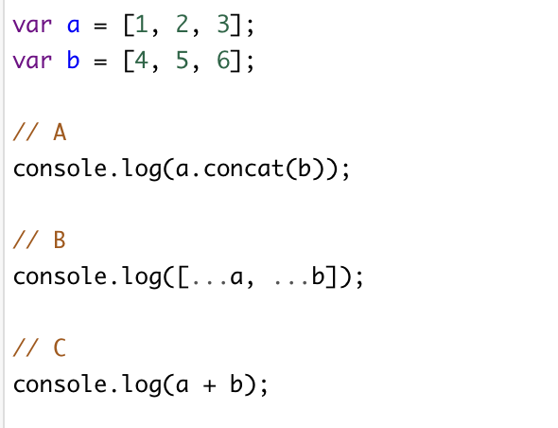
Consider two arrays a and b below. Which option below is NOT correct to merge the arrays?
A. A
B. B
C. C
D. All of them

Slide 16
What is the output of the following code? console.log([1,2,3] + [4,5,6] );
A. error
B. [1, 2, 3, 4, 5, 6]
C. “1, 2, 34, 5, 6”
D. “[1, 2, 3][4, 5, 6]”

Slide 17
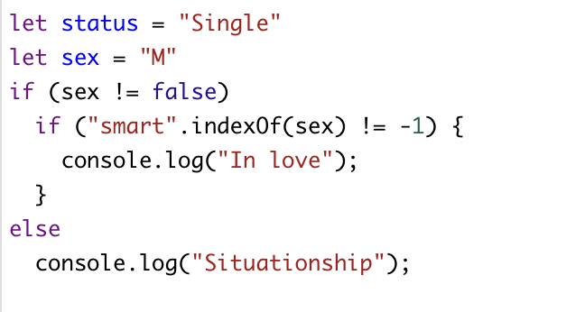
What is the output of the following code?
A. Nothing / she’s still single
B. In love
C. Situationship
D. None of the above

Slide 18
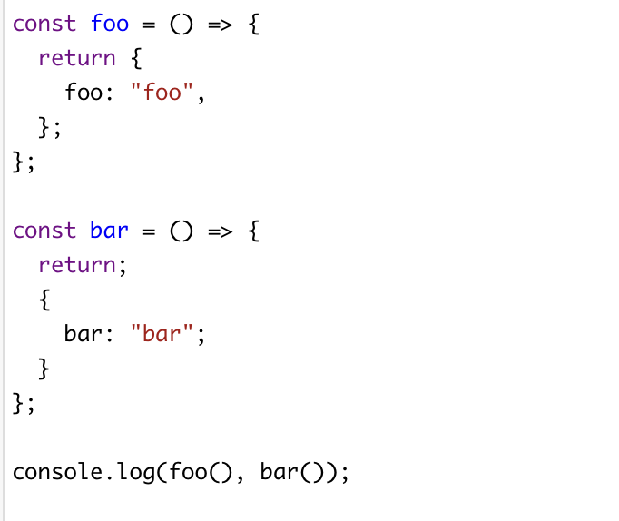
What is the output of the following code?
A. { foo: "foo" } undefined
B. undefined { bar: "bar" }
C. undefined undefined
D. { foo: "foo" } { bar: "bar" }

Slide 19
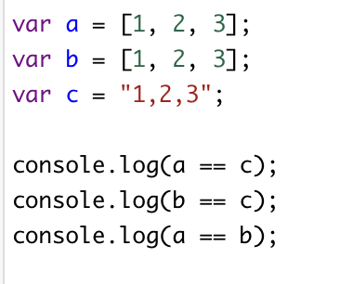
What is the output of the following code?
A. true, true, false
B. true, true, true
C. true, false, false
D. false, false false

Slide 20
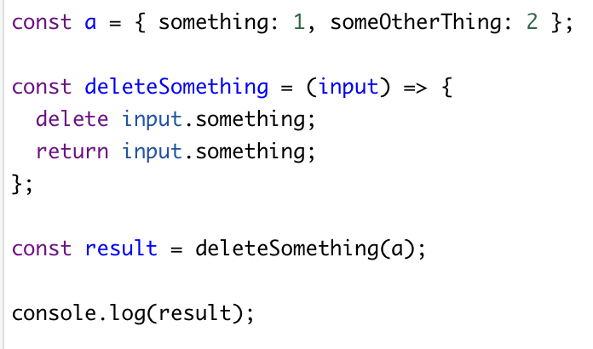
What is the output of the following code?
A. 1
B. error
C. undefined
D. 2

Slide 21
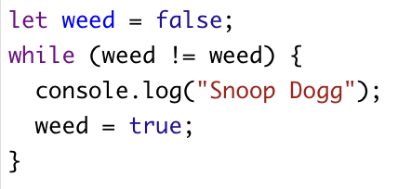
What is the output of the following code?
A. Smoke weed for ever
B. compile error
C. No output
D. Invalid Js
E. None of the above

Slide 22
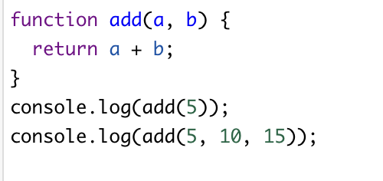
What is the output of the following code?
A. NaN error
B. error error
C. undefined 15
D. NaN 15

Slide 23
What is the output of the following code?
A. -1
B. 0
C. 2
D. None of the above

Slide 24
What is the output of the following code?
A. SOEN, SOEN-287, 2
B. SOEN-287, SOEN-287, 287
C. null, SOEN-287, null
D. S, SOEN-287, 2
E. I don’t know

Slide 25
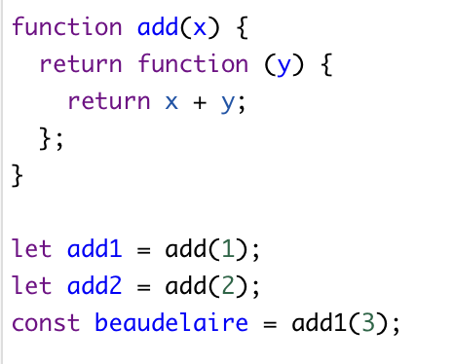
What is the value of beaudelaire?
A. 1
B. 2
C. 3
D. 4
E. None of the above

Slide 26
True or False: The document object is contained in the window object.

Slide 27
True or False: console.log(typeof new Number(123)) returns number?

Slide 28
True or False: console.log(Number(123)) returns [object]?

Slide 29
True or False: console.log('6 apples' < 10) return false ?

Slide 30
The End

