Slide 1
Welcome To
Beaudelaire’s
Tutorial
Tutorial #11

Slide 2
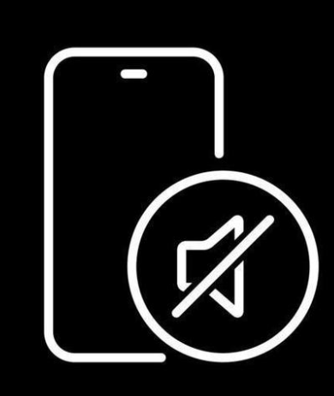
Please put your phone on silent mode to avoid interruptions

Slide 3
Brain Teasers

Slide 4
Which of the following methods will NOT work to select all paragraph elements on a page?
A. document.getElementsByTagName('p')
B. document.querySelectorAll('p')
C. document.selectAll('p’)
D. Array.from(document.body.getElementsByTagName('p'))

Slide 5
What's the correct way to change the background color of an element with id "myElement" to red?
A. document.getElementById('myElement').style = 'background-color: red;'
B. document.getElementById('myElement').style.backgroundColor = 'red'
C. document.getElementById('myElement').css('background-color', 'red’)
D. Both a and b

Slide 6
What does the following code output?
A. First
B. Second
C. Third
D. Second Third

Slide 7
What does the Event Propagation Model in web development describe?
A. The process of how events are stored in the browser's memory.
B. The method by which an event moves through the DOM hierarchy
C. A system that tracks user login events across multiple sessions.
D. A framework for handling server-side request and response events.

Slide 8
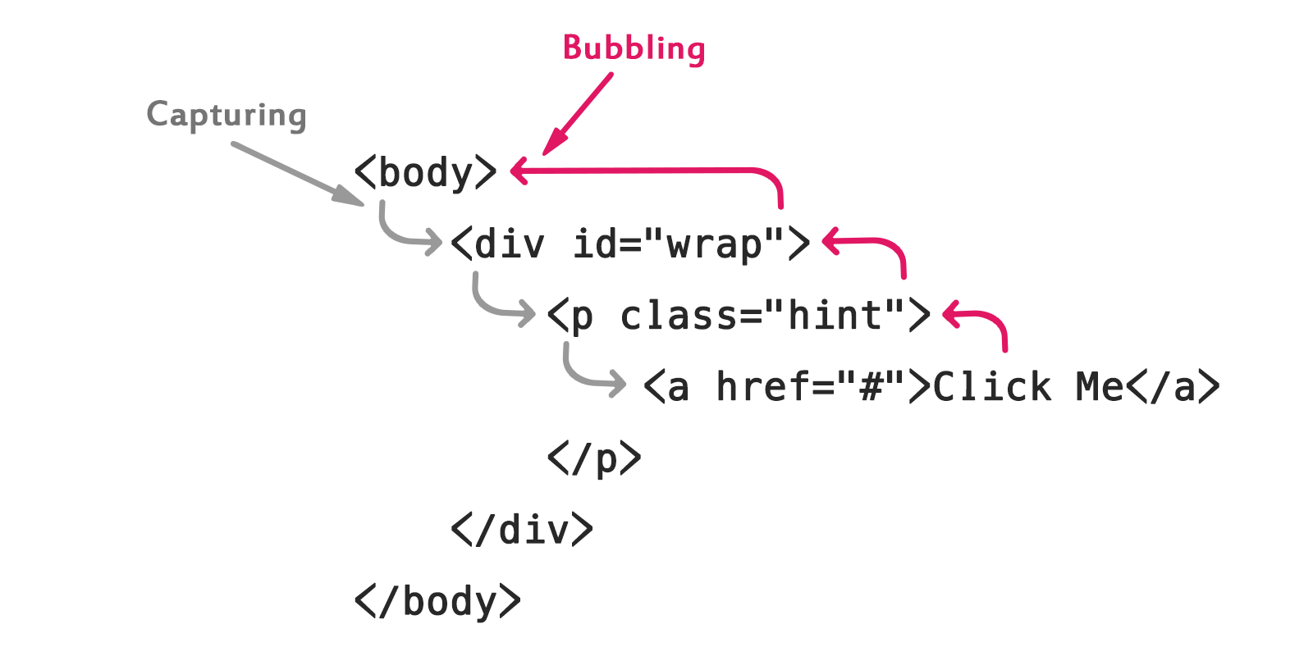
In the context of event propagation, what's the correct order of phases?
A. Target phase, Capturing phase, Bubbling phase
B. Capturing phase, Target phase, Bubbling phase
C. Bubbling phase, Target phase, Capturing phase
D. Target phase, Bubbling phase, Capturing phase

Slide 9
When can you stop the propagation of an event
A. Target phase
B. Capturing phase
C. Bubbling phase
D. Any Phase

Slide 10
What is the correct answer for the following respectively?
1. If the <a> tag is clicked, can a click event on the <body> element also be triggered due to event propagation?
2. If there's a second <a> element placed under the first one, can clicking the first <a> element also trigger a click event on the second one?
A. True, True
B. True, False
C. False, True
D. False, False

Slide 11
Which of the following event is fired when an element loses focus, and its value was changed?
A. blur
B. change
C. select
D. click

Slide 12
Which of the following will NOT give focus to an input element with id "myInput"?
A. document.getElementById('myInput').focus()
B. document.getElementById('myInput').select()
C. document.getElementById('myInput').click()
D. document.getElementById('myInput').blur()

Slide 13
What will be logged if the user clicks on "Blue"?
A. blue
B. Blue
C. undefined
D. It depends on the browser

Slide 14
What's the difference between element.innerHTML and element.outerHTML?
A. innerHTML includes the element itself, outerHTML doesn't
B. outerHTML includes the element itself, innerHTML doesn't
C. There is no difference
D. innerHTML is faster but less secure

Slide 15
What is the output of the following code? (offsetHeight is a property that returns the height of an element including vertical padding and borders, as an integer)
A. 0
B. undefined
C. null
D. None of the above

Slide 16
What's the purpose of the capture phase in event propagation?
A. To capture the event before it reaches the target (Tell parent first)
B. To improve event handling performance
C. To allow parent elements to handle events before child elements
D. To ensure all elements in the DOM tree are notified of the event programming.

Slide 17
What's the difference between event.preventDefault() and event.stopPropagation()?
A. preventDefault stops the event from bubbling, stopPropagation cancels the default action
B. preventDefault cancels the default action, stopPropagation stops the event from bubbling
C. There is no difference, they can be used interchangeably
D. preventDefault is for form events, stopPropagation is for mouse events

Slide 18
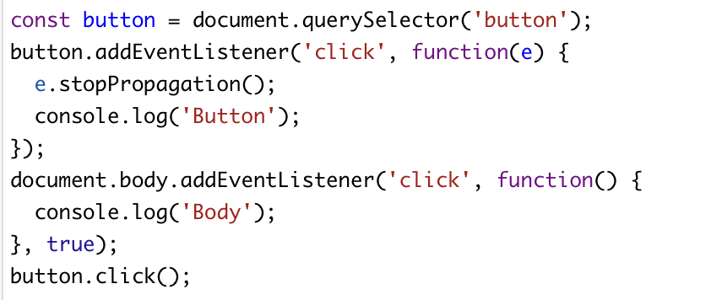
What will the following code log? The third parameter, true, means the event listener is set in the capturing phase.
A. Button
B. Body
C. Body Button
D. Button Body

Slide 19
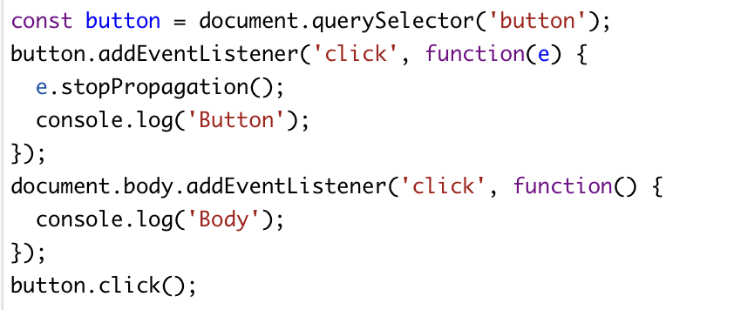
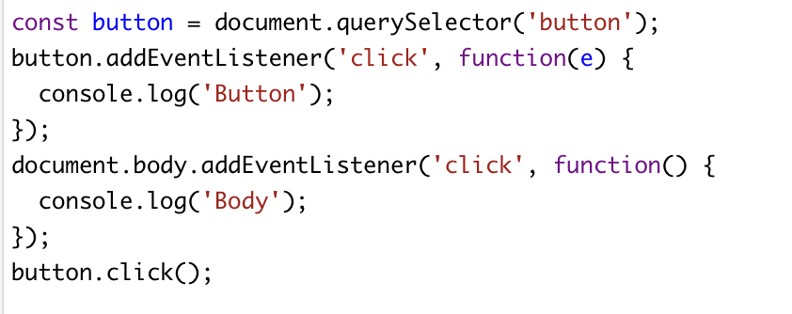
What will the following code log, 1 and 2 respectively?
1.
A. Button, Button Body
B. Button, Body Button
C. Body Button, Body
D. Button Body, Button
2.

Slide 20
Which of the following are NOT valid JavaScript variable name?
A. _myVar
B. $myVar
C. my-Var
D. switch
E. myVa2r

Slide 21
When does the ‘DOMContentLoaded’ event trigger?
A. When the HTML document is completely loaded and parsed
B. When the entire page (including images) is loaded
C. When the browser starts parsing the HTML
D. When all scripts are executed

Slide 22
What is the use of ‘localStorage’ in JavaScript?
A. To store data temporarily
B. To store data permanently
C. To store data that expires after a session
D. o store data on the server

Slide 23
What does DOM stand for?
A. Document Object Model
B. Document Oriented Model
C. Data Object Model
D. Data Oriented Model

Slide 24
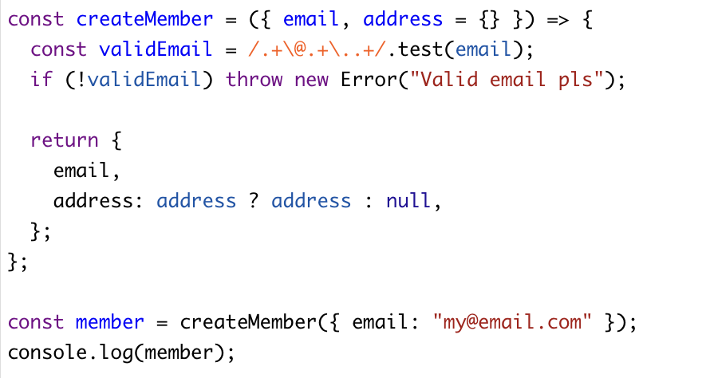
What is the output of the following code?
A. { email: "my@email.com", address : null }
B. { email: "my@email.com" }
C. { email: "my@email.com", address : { } }
D. { email: "my@email.com", address : undefined }

Slide 25
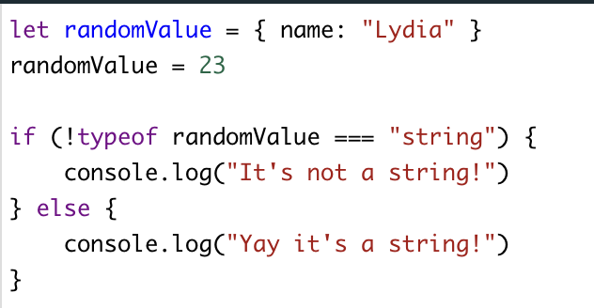
What is the output of the following code?
A. It’s not a string
B. Yay it’s a string
C. error
D. undefined

Slide 26
What is the default value of the ‘position’ property in CSS?
A. absolute
B. relative
C. fixed
D. static

Slide 27
What value will I give to ‘position’ property in other to use a coordinate system relative to the upper and left corner of the client area?
A. absolute
B. static
C. fixed
D. relative

Slide 28
How to move a point from (12, 34) to (56, 76) with css
A. top=76px, left= 56px
B. top=56px, left=76px
C. left=34px, bottom=76px
D. left=12px, bottom=34px

Slide 29
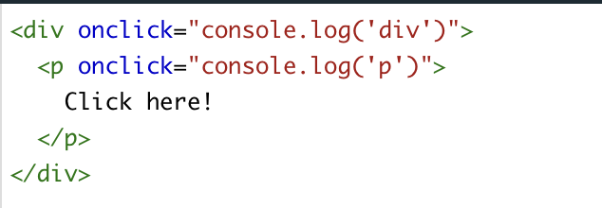
What is the output of the following code?
A. p div
B. div p
C. p
D. div

Slide 30
What is the output of the following code?
A. First Second Third
B. First Third Second
C. Second First Third
D. Second Third Second

Slide 31
Which of the following is the correct way to apply the same style to multiple HTML elements using a group selector in CSS?
A. div p span { color: red; }
B. div, p, span { color: red; }
C. div + p + span { color: red; }
D. div > p > span { color: red; }
E. None of the above

Slide 32
In HTML5, which tag is used for graphics and graphical applications that can be drawn on the fly, typically with JavaScript?
A. <canvas>
B. <draw>
C. <graphic>
D. <art>

Slide 33
Which of the following statements about clientX/Y and screenX/Y is correct?
A. clientX/Y values change when the page is scrolled, but screenX/Y values remain constant
B. screenX/Y values are always larger than clientX/Y values
C. clientX/Y are relative to the viewport (client area), while screenX/Y are relative to the entire screen
D. clientX/Y and screenX/Y will always be equal when the browser window is maximized

Slide 34
When dealing with a scaled webpage (e.g., using browser zoom or CSS scaling), which statement is true?
A. Both clientX/Y and screenX/Y will be scaled proportionally
B. clientX/Y will be scaled, but screenX/Y will remain unaffected
C. screenX/Y will be scaled, but clientX/Y will remain unaffected
D. Neither clientX/Y nor screenX/Y will be affected by scaling

Slide 35
Which property is used to hide an element, so it takes no space in the layout?
A. display: none
B. visibility: hidden
C. opacity: 0
D. visibility: none

Slide 36
Which of the following is NOT a JavaScript data type?
A. String
B. Boolean
C. Integer
D. Undefined

Slide 37
What does the ‘useCapture’ parameter in addEventListener() specify?
A. Whether to use bubbling or capturing event propagation
B. Whether to use default or custom event handler
C. Whether to use synchronous or asynchronous event handling
D. Whether to use internal or external event listener

Slide 38
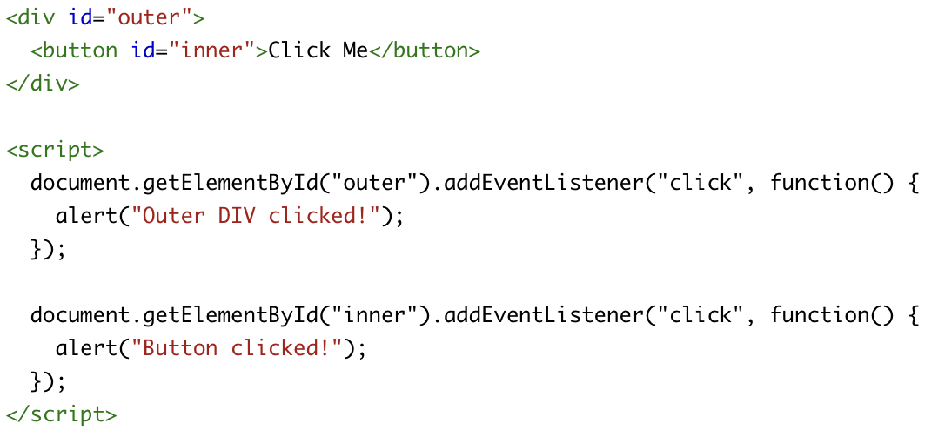
What happens when the button is clicked?
A. Only “Outer DIV clicked!” shows
B. Only “Button clicked!” shows
C. Both alerts show — button first, then div
D. Both alerts show — div first, then button

Slide 39
What event phase is responsible for triggering the div's alert after the button is clicked?
A. Target phase
B. Capturing phase
C. Bubbling phase
D. None of the above

Slide 40
How can you make the outer div respond to the event before the button?
A. Use stopPropagation()
B. Use addEventListener('click', handler, true) on the div
C. Use onclick instead of addEventListener
D. Remove the button's event handler

Slide 41
True or False: All global variables and functions are properties of the window object

Slide 42
True or False: console.log(undefined + undefined) is undefined

Slide 43
The End

